Slide 1
Lecture -15-18
Advanced Mechanical Vibration
Forced vibration SDOF systems

Slide 2
Introduction
In case of forced vibration there is impressed forced in the system which keeps it vibrating.
Examples: Vibration of air compressor, IC engines, Machine tools and other machineries.
Types of forcing function:
Periodic forcing function : Harmonic and non-harmonic
Impulsive forcing function. Gives transient vibration
Random forcing function. Example: earth quake and acoustic excitation.

Slide 3












Forced vibration with harmonic excitation
K x
$$C\dot{x}$$
$$m\ddot{x}$$
C
$K$
$K$
C
$$\ddot{x}$$
m
$$F_{0}\sin{ωt}$$
$$x$$
$$m\ddot{x}=−Kx−C\dot{x}+F_{0}\sin{ωt}$$
m
$$x,$$
$\dot{x}$,
$$\ddot{x}$$
$$F_{0}\sin{ωt}$$
This is a linear, non-homogeneous, second order differential equation.
Important: The gravitational force and spring force due to static deflection are not considered in modelling as these two neutralizes with each other.

Slide 4
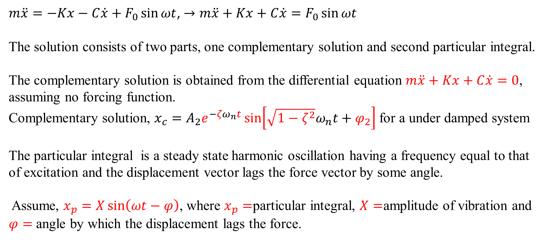
Forced vibration with harmonic excitation (Solution)
$m\ddot{x}=−Kx−C\dot{x}+F_{0}\sin{ωt}$, $→m\ddot{x}+Kx+C\dot{x}=F_{0}\sin{ωt}$
The solution consists of two parts, one complementary solution and second particular integral.
The complementary solution is obtained from the differential equation $m\ddot{x}+Kx+C\dot{x}=0$, assuming no forcing function.
Complementary solution, $x_{c}=A_{2}e^{{−ζω}_{n}t}\sin\left[\sqrt{1−ζ^{2}}ω_{n}t+φ_{2}\right]$for a under damped system
The particular integral is a steady state harmonic oscillation having a frequency equal to that of excitation and the displacement vector lags the force vector by some angle.
Assume, $x_{p}=X\sin\left(ωt−φ\right)$, where $x_{p}=$particular integral, $X=$amplitude of vibration and $φ=$ angle by which the displacement lags the force.

Slide 5
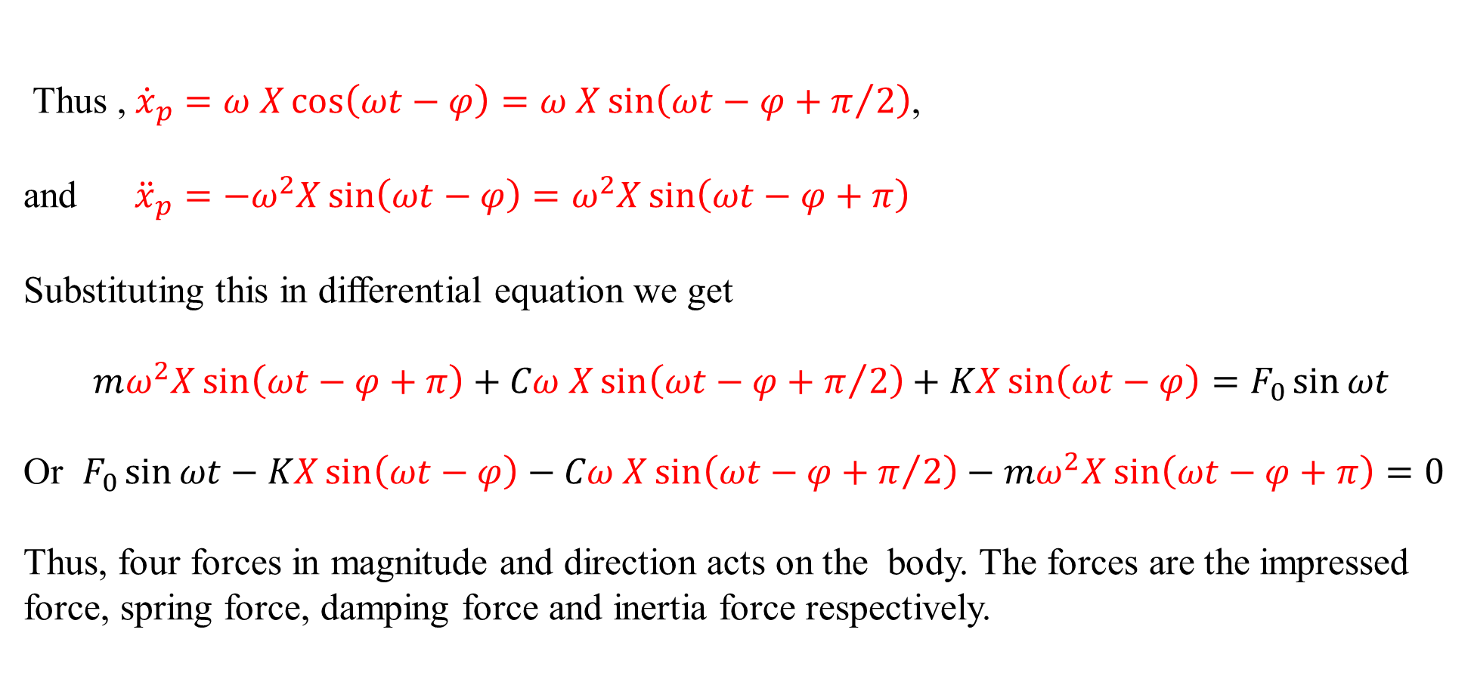
Forced vibration with harmonic excitation (Solution)
Thus , ${\dot{x}}_{p}=ω X\cos\left(ωt−φ\right)=ω X\sin\left(ωt−φ+π/2\right)$,
and ${\ddot{x}}_{p}=−ω^{2}X\sin\left(ωt−φ\right)=ω^{2}X\sin\left(ωt−φ+π\right)$
Substituting this in differential equation we get
$$mω^{2}X\sin\left(ωt−φ+π\right)+Cω X\sin\left(ωt−φ+π/2\right)+KX\sin\left(ωt−φ\right)=F_{0}\sin{ωt}$$
Or $F_{0}\sin{ωt}−KX\sin\left(ωt−φ\right)−Cω X\sin\left(ωt−φ+π/2\right)−mω^{2}X\sin\left(ωt−φ+π\right)=0$
Thus, four forces in magnitude and direction acts on the body. The forces are the impressed force, spring force, damping force and inertia force respectively.

Slide 6






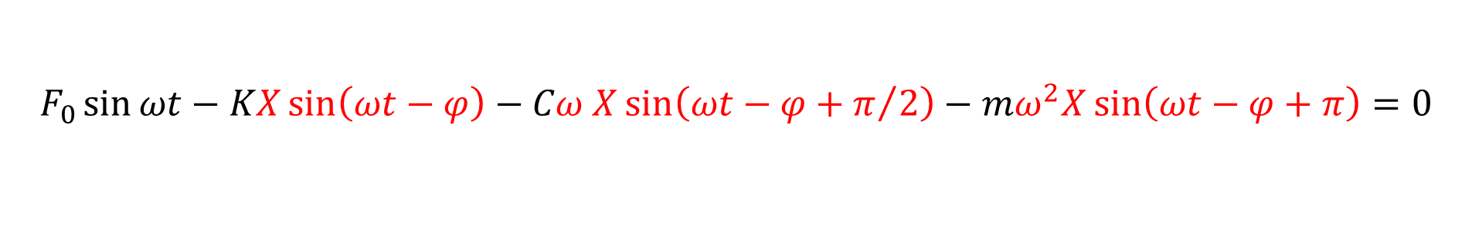











Forced vibration with harmonic excitation (Solution)
Perpendicular axis
$$A$$
$$B$$
$$F_{0}$$
$$A$$
$$K X$$
$$x$$
$$KX−mω^{2}X$$
$$φ$$
$$ωt$$
$$B$$
$$φ$$
$$F_{0}$$
$$Cω X$$
$$O$$
Reference axis
$$mω^{2}X$$
$$Cω X$$
$$O$$
$$F_{0}\sin{ωt}−KX\sin\left(ωt−φ\right)−Cω X\sin\left(ωt−φ+π/2\right)−mω^{2}X\sin\left(ωt−φ+π\right)=0$$

Slide 7
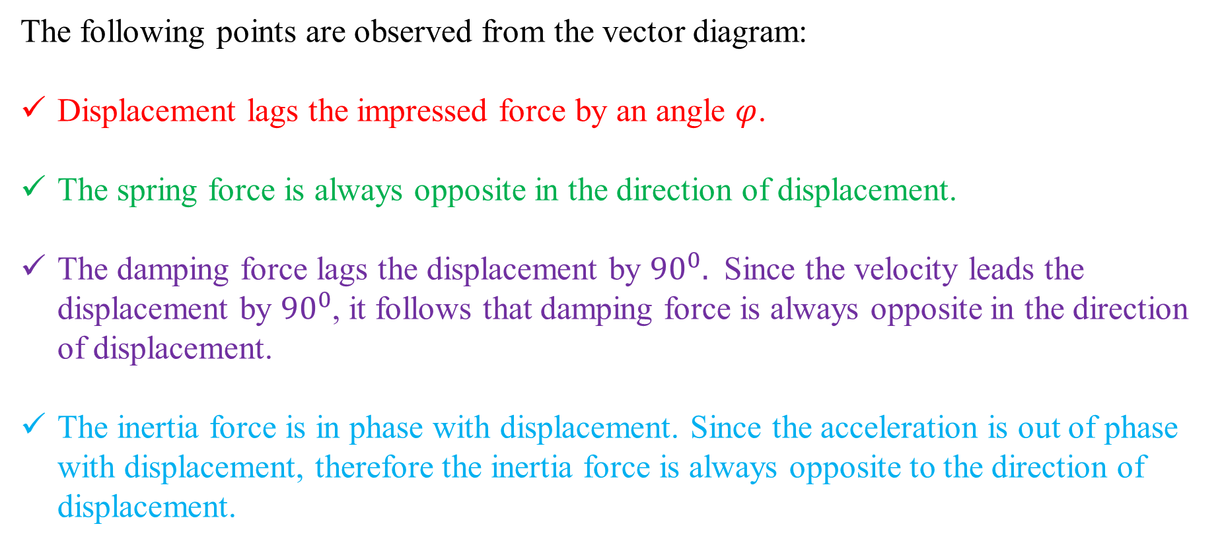
Forced vibration with harmonic excitation (Solution)
The following points are observed from the vector diagram:
Displacement lags the impressed force by an angle $φ$.
The spring force is always opposite in the direction of displacement.
The damping force lags the displacement by ${90}^{0}.$ Since the velocity leads the displacement by ${90}^{0}$, it follows that damping force is always opposite in the direction of displacement.
The inertia force is in phase with displacement. Since the acceleration is out of phase with displacement, therefore the inertia force is always opposite to the direction of displacement.

Slide 8

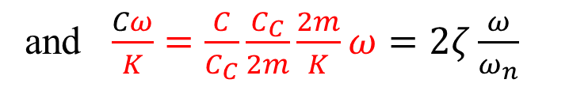


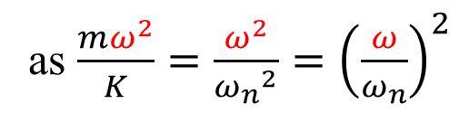


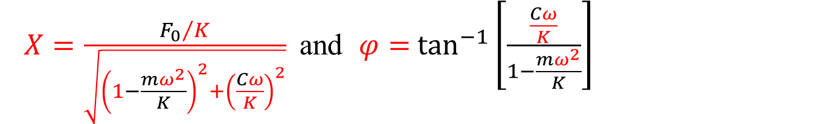

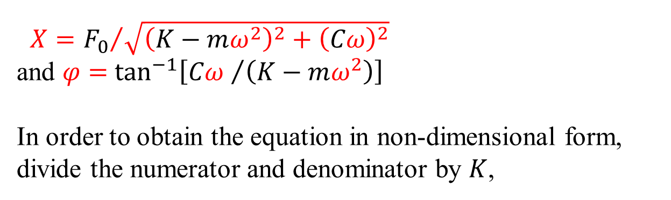

Forced vibration with harmonic excitation (Solution)
To find the values of $X$ and $φ$ consider the right angle triangle $OAB,$ from which:
$$A$$
$X={F_{0}}/{\sqrt{{\left(K−mω^{2}\right)}^{2}+{\left(Cω\right)}^{2}}}$
and $φ=$ $\tan^{−1}\left[{Cω }/{\left(K−mω^{2}\right)}\right]$
In order to obtain the equation in non-dimensional form, divide the numerator and denominator by $K$,
$$KX−mω^{2}X$$
$$B$$
$$φ$$
$$F_{0}$$
$$Cω X$$
$$O$$
$X=\frac{{F_{0}}/K}{\sqrt{{\left(1−\frac{mω^{2}}{K}\right)}^{2}+{\left(\frac{Cω}{K}\right)}^{2}}}$ and $φ=$ $\tan^{−1}\left[\frac{\frac{Cω}{K}}{1−\frac{mω^{2}}{K}}\right]$
as $\frac{mω^{2}}{K}=\frac{ω^{2}}{{ω_{n}}^{2}}={\left(\frac{ω}{ω_{n}}\right)}^{2}$
and $\frac{Cω}{K}=\frac{C}{C_{C}}\frac{C_{C}}{2m}\frac{2m}{K}ω=2ζ\frac{ω}{ω_{n}}$

Slide 9
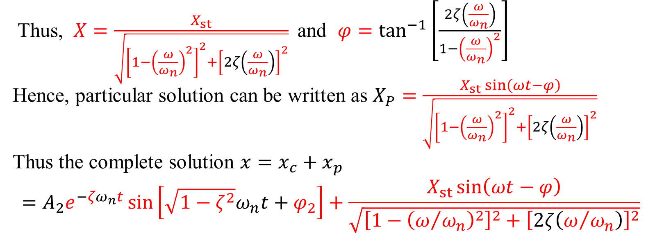
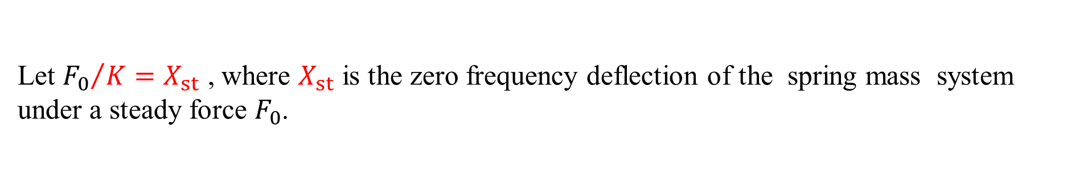
Forced vibration with harmonic excitation (Solution)
Let ${F_{0}}/K=X_{st}$ , where $X_{st}$ is the zero frequency deflection of the spring mass system under a steady force $F_{0}$.
Thus, $X=\frac{X_{st}}{\sqrt{{\left[1−{\left(\frac{ω}{ω_{n}}\right)}^{2}\right]}^{2}+{\left[2ζ\left(\frac{ω}{ω_{n}}\right)\right]}^{2}}}$ and $φ=\tan^{−1}\left[\frac{2ζ\left(\frac{ω}{ω_{n}}\right)}{1−{\left(\frac{ω}{ω_{n}}\right)}^{2}}\right]$
Hence, particular solution can be written as $X_{P}=\frac{X_{st}\sin\left(ωt−φ\right)}{\sqrt{{\left[1−{\left(\frac{ω}{ω_{n}}\right)}^{2}\right]}^{2}+{\left[2ζ\left(\frac{ω}{ω_{n}}\right)\right]}^{2}}}$
Thus the complete solution $x=x_{c}+x_{p}$
$$=A_{2}e^{{−ζω}_{n}t}\sin\left[\sqrt{1−ζ^{2}}ω_{n}t+φ_{2}\right]+\frac{X_{st}\sin\left(ωt−φ\right)}{\sqrt{{\left[1−{\left(ω/{ω_{n}}\right)}^{2}\right]}^{2}+{\left[2ζ\left(ω/{ω_{n}}\right)\right]}^{2}}}$$
The first part (complementary solution ) is called transient vibration and the second part (particular solution) is called steady state vibration.

Slide 10
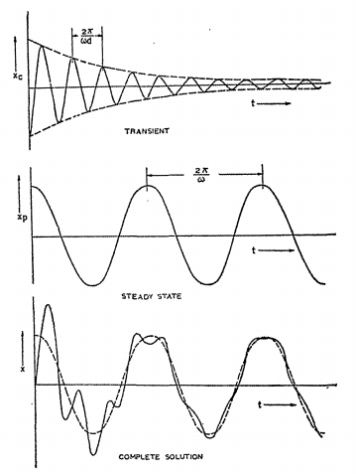
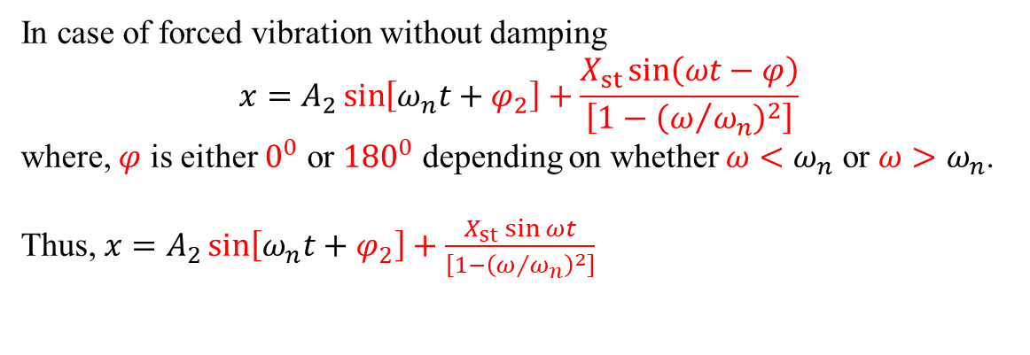
Forced vibration with harmonic excitation (Solution)
The first part (complementary solution ) decays with time and vanishes ultimately called transient vibration. The second part (particular integral) is having a constant amplitude therefore, called steady state vibration.
Transient vibration take place at damped natural frequency and the steady state vibration occurs at the frequency of excitation of the system.
In case of forced vibration without damping
$$x=A_{2}\sin\left[ω_{n}t+φ_{2}\right]+\frac{X_{st}\sin\left(ωt−φ\right)}{\left[1−{\left(ω/{ω_{n}}\right)}^{2}\right]}$$
where, $φ$ is either $0^{0}$ or ${180}^{0}$ depending on whether $ω<ω_{n}$ or ${ω>ω}_{n}$.
Thus, $x=A_{2}\sin\left[ω_{n}t+φ_{2}\right]+\frac{X_{st}\sin{ωt}}{\left[1−{\left(ω/{ω_{n}}\right)}^{2}\right]}$

Slide 11
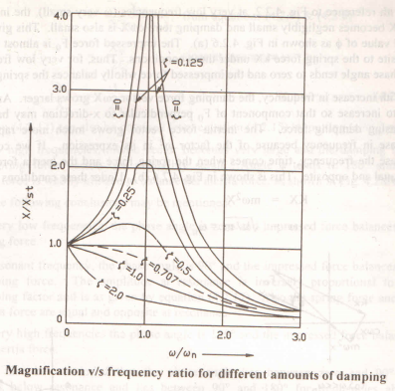
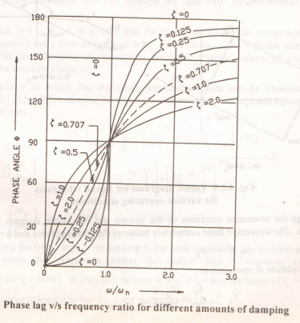
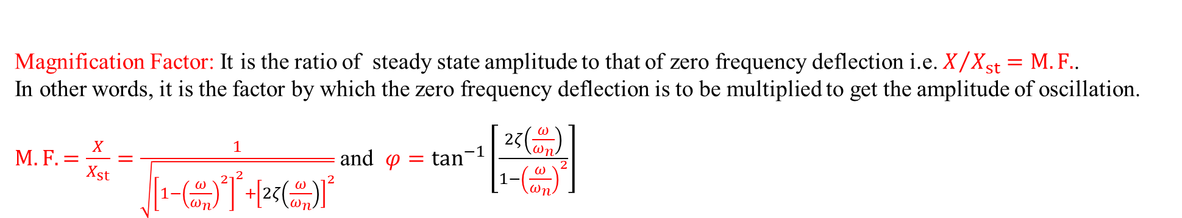
Steady state vibrations
Magnification Factor: It is the ratio of steady state amplitude to that of zero frequency deflection i.e. $X/{X_{st}}=M.F.$.
In other words, it is the factor by which the zero frequency deflection is to be multiplied to get the amplitude of oscillation.
$M.F.=\frac{X}{X_{st}}=\frac{1}{\sqrt{{\left[1−{\left(\frac{ω}{ω_{n}}\right)}^{2}\right]}^{2}+{\left[2ζ\left(\frac{ω}{ω_{n}}\right)\right]}^{2}}}$ and $φ=\tan^{−1}\left[\frac{2ζ\left(\frac{ω}{ω_{n}}\right)}{1−{\left(\frac{ω}{ω_{n}}\right)}^{2}}\right]$

Slide 12
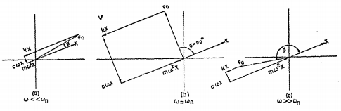
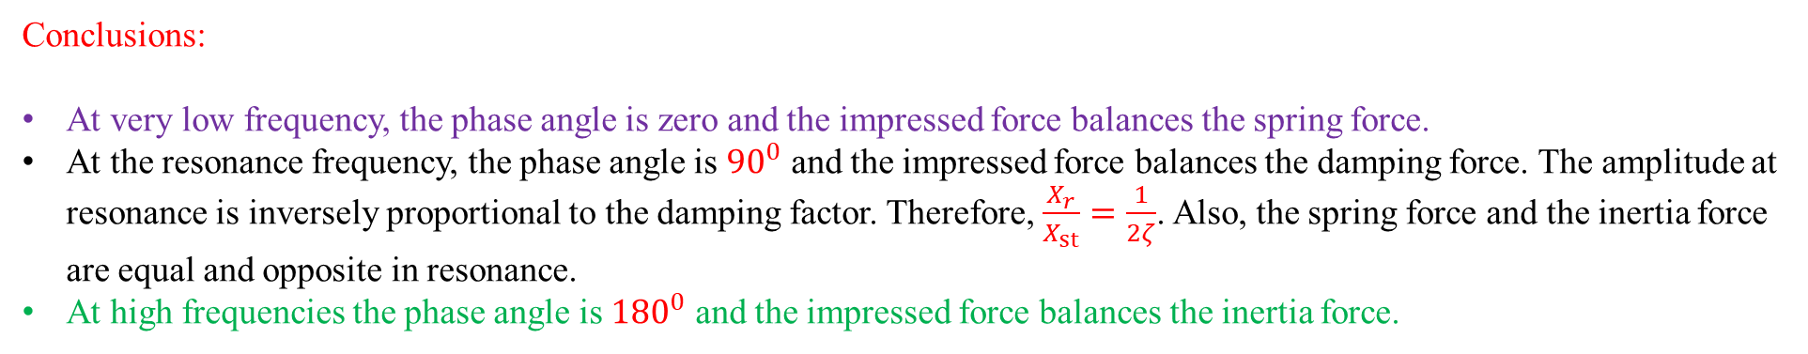
Steady state vibrations
Conclusions:
At very low frequency, the phase angle is zero and the impressed force balances the spring force.
At the resonance frequency, the phase angle is ${90}^{0}$ and the impressed force balances the damping force. The amplitude at resonance is inversely proportional to the damping factor. Therefore, $\frac{X_{r}}{X_{st}}=\frac{1}{2ζ}$. Also, the spring force and the inertia force are equal and opposite in resonance.
At high frequencies the phase angle is ${180}^{0}$ and the impressed force balances the inertia force.

Slide 13
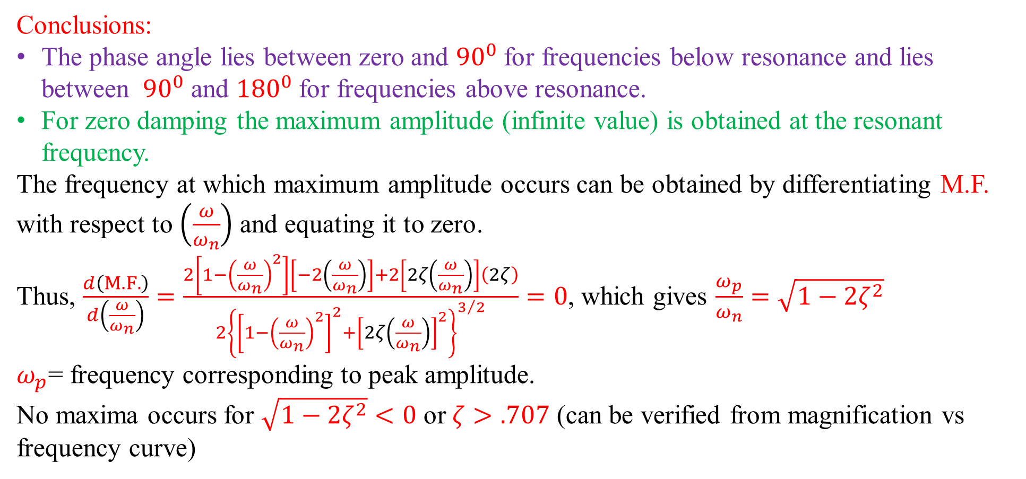
Steady state vibrations
Conclusions:
The phase angle lies between zero and ${90}^{0}$ for frequencies below resonance and lies between ${90}^{0}$ and ${180}^{0}$ for frequencies above resonance.
For zero damping the maximum amplitude (infinite value) is obtained at the resonant frequency.
The frequency at which maximum amplitude occurs can be obtained by differentiating M.F. with respect to $\left(\frac{ω}{ω_{n}}\right)$ and equating it to zero.
Thus, $\frac{d\left(M.F.\right)}{d\left(\frac{ω}{ω_{n}}\right)}=\frac{2\left[1−{\left(\frac{ω}{ω_{n}}\right)}^{2}\right]\left[−2\left(\frac{ω}{ω_{n}}\right)\right]+2\left[2ζ\left(\frac{ω}{ω_{n}}\right)\right]\left(2ζ\right)}{2{\left\{{\left[1−{\left(\frac{ω}{ω_{n}}\right)}^{2}\right]}^{2}+{\left[2ζ\left(\frac{ω}{ω_{n}}\right)\right]}^{2}\right\}}^{3/2}}=0$, which gives $\frac{ω_{p}}{ω_{n}}=\sqrt{1−2ζ^{2}}$
$ω_{p}$= frequency corresponding to peak amplitude.
No maxima occurs for $\sqrt{1−2ζ^{2}}<0$ or $ζ>.707$ (can be verified from magnification vs frequency curve)

Slide 14
Steady state vibrations
A periodic torque is having a maximum value of 0.588 N-m at a frequency corresponding to 4radian per second is impressed upon a flywheel suspended from wire. The wheel has a moment of inertia of 0.12 kg-m² and the wire has a stiffness of 1.176 N-m/rad. A viscous dashpot applies damping couple of 0.392 N-m at an angular velocity of 1 rad/sec. calculate
(a) The maximum angular displacement from rest position, (b) maximum couple applied at the dashpot and (c) the angle by which the angular displacement lags the torque.

Slide 15
Steady state vibrations
The damped natural frequency of the system as obtained from a free vibration test is 9.8 Hz. During the forced vibration test with constant exciting force on the same system, the maximum amplitude of vibration is found to be 9.6 Hz. Find the damping factor for the system and its natural frequency.

Slide 16
Steady state vibrations
A system of beams supports a motor of mass 1200 kg. The motor has an unbalanced mass of 1 kg located at 6.00 cm radius. It is known that the resonance occurs at 2210 rpm. What amplitude of vibration can be expected at the motor’s operating speed of 1440 rpm if the damping factor is assumed to be less than 0.1.

Slide 17
Steady state vibrations
A single cylinder vertical petrol engine of total mass 320 kg is mounted upon a steel chassis frame and causes a vertical static deflection of 0.2 cm. The reciprocating part of the engine have a mass of 24 kg and move through a vertical stoke of 15 cm with SHM. A dashpot is provided and the damping resistance of which is directly proportional to the velocity and amount to 490 N at 0.3 m/s. Determine
The speed of driving shaft at which the resonance occurs.
The amplitude of steady state forced vibrations when the driving shaft of the engine rotates at 480 rpm.

Slide 18
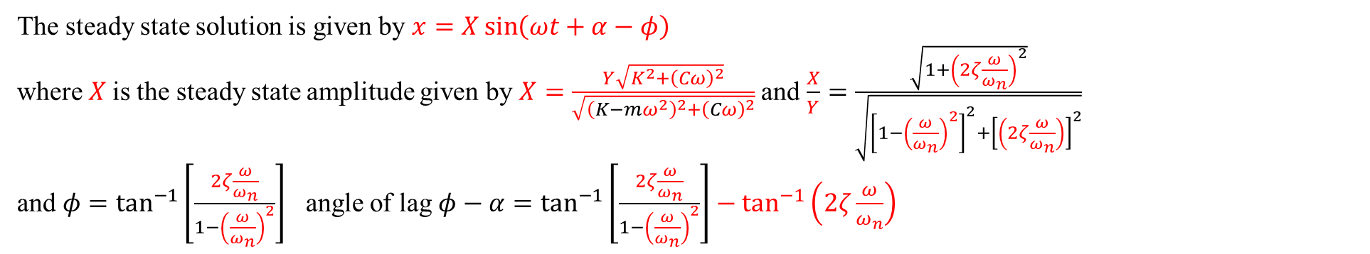
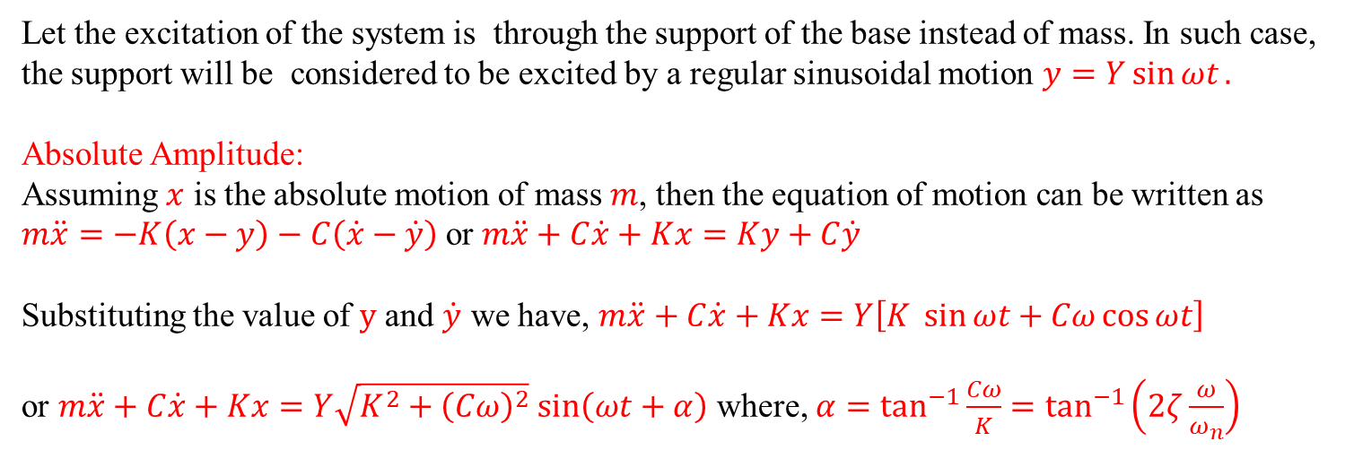


Forced vibrations due to excitation of support
Let the excitation of the system is through the support of the base instead of mass. In such case, the support will be considered to be excited by a regular sinusoidal motion $y=Y\sin{ωt}.$
Absolute Amplitude:
Assuming $x$ is the absolute motion of mass $m$, then the equation of motion can be written as $m\ddot{x}=−K\left(x−y\right)−C\left(\dot{x}−\dot{y}\right)$ or $m\ddot{x}+C\dot{x}+Kx=Ky+C\dot{y}$
Substituting the value of $y$ and $\dot{y}$ we have, $m\ddot{x}+C\dot{x}+Kx=Y\left[K \sin{ωt}+Cω\cos{ωt}\right]$
or $m\ddot{x}+C\dot{x}+Kx=Y\sqrt{K^{2}+{\left(Cω\right)}^{2}}$ $\sin\left(ωt+α\right)$ where, $α=\tan^{−1}{\frac{Cω}{K}}=\tan^{−1}\left(2ζ\frac{ω}{ω_{n}}\right)$
$$y$$
C
$K$
m
$$x$$
The steady state solution is given by $x=X\sin\left(ωt+α−φ\right)$
where $X$is the steady state amplitude given by $X=\frac{Y\sqrt{K^{2}+{\left(Cω\right)}^{2}}}{\sqrt{{\left(K−mω^{2}\right)}^{2}+{\left(Cω\right)}^{2}}}$ and $\frac{X}{Y}=\frac{\sqrt{1+{\left(2ζ\frac{ω}{ω_{n}}\right)}^{2}}}{\sqrt{{\left[1−{\left(\frac{ω}{ω_{n}}\right)}^{2}\right]}^{2}+{\left[\left(2ζ\frac{ω}{ω_{n}}\right)\right]}^{2}}}$
and $φ=\tan^{−1}\left[\frac{2ζ\frac{ω}{ω_{n}}}{1−{\left(\frac{ω}{ω_{n}}\right)}^{2}}\right]$ angle of lag $φ−α=\tan^{−1}\left[\frac{2ζ\frac{ω}{ω_{n}}}{1−{\left(\frac{ω}{ω_{n}}\right)}^{2}}\right]−\tan^{−1}\left(2ζ\frac{ω}{ω_{n}}\right)$

Slide 19
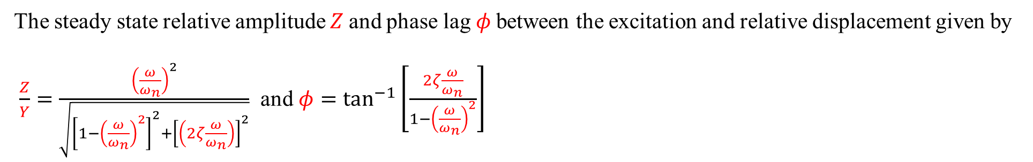
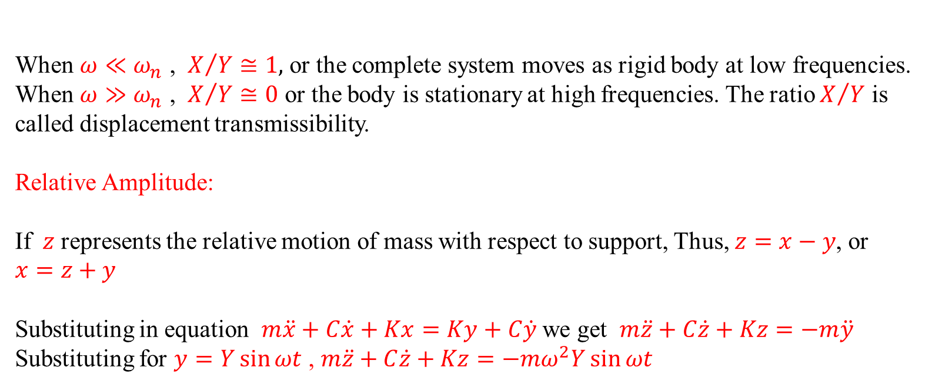
Forced vibrations due to excitation of support
When $ω≪ω_{n}$ , $X/Y≅1,$ or the complete system moves as rigid body at low frequencies.
When $ω≫ω_{n}$ , $X/Y≅0$ or the body is stationary at high frequencies. The ratio $X/Y$ is called displacement transmissibility.
Relative Amplitude:
If $z$ represents the relative motion of mass with respect to support, Thus, $z=x−y$, or $x=z+y$
Substituting in equation $m\ddot{x}+C\dot{x}+Kx=Ky+C\dot{y}$ we get $m\ddot{z}+C\dot{z}+Kz=−m\ddot{y}$
Substituting for $y=Y\sin{ωt}$ , $m\ddot{z}+C\dot{z}+Kz=−mω^{2}Y\sin{ωt}$
$$y$$
C
$K$
m
$$x$$
The steady state relative amplitude $Z$and phase lag $φ$between the excitation and relative displacement given by
$\frac{Z}{Y}=\frac{{\left(\frac{ω}{ω_{n}}\right)}^{2}}{\sqrt{{\left[1−{\left(\frac{ω}{ω_{n}}\right)}^{2}\right]}^{2}+{\left[\left(2ζ\frac{ω}{ω_{n}}\right)\right]}^{2}}}$ and $φ=\tan^{−1}\left[\frac{2ζ\frac{ω}{ω_{n}}}{1−{\left(\frac{ω}{ω_{n}}\right)}^{2}}\right]$

Slide 20
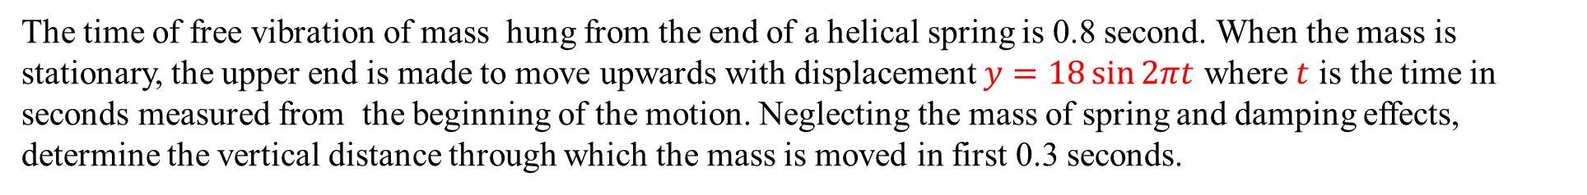
Forced vibrations due to excitation of support
The time of free vibration of mass hung from the end of a helical spring is 0.8 second. When the mass is stationary, the upper end is made to move upwards with displacement $y=18\sin{2πt}$ where $t$ is the time in seconds measured from the beginning of the motion. Neglecting the mass of spring and damping effects, determine the vertical distance through which the mass is moved in first 0.3 seconds.

Slide 21
Forced vibrations due to excitation of support
The support of a spring-mass system is vibrating with amplitude of 5 mm and a frequency of 1150 cycles/min. if the mass is 0.9 kg and the spring has a stiffness of 1960 N/m, determine the amplitude of vibration of the mass. What amplitude will result if a damping factor of 0.2 is included in the system ?

Slide 22
Forced vibrations due to excitation of support
The spring of an automobile trailer are compressed 0.1 m under its own weight. Find the critical speed when the trailer is travelling over a road with a profile approximated by a sine wave of amplitude 0.09 m and wave length of 14 meters. What will be the amplitude of vibration at 60 km/hour.

Slide 23
Vibration isolation and transmissibility
Many kinds of vibrations are undesirable and therefore should be eliminated or at least reduced. The inertia force developed in a reciprocating engine or unbalanced forces produced in any other rotating machinery should be isolated from the foundation so that the adjoining structure is not set into heavy vibration.
Effectiveness of isolation may be measured in term of force or motion transmitted to that in existence.
Force isolation
Motion isolation
The lesser the force or motion transmitted the grater is said to be the isolation.
Way of reducing transmitted vibrations by vibration isolation, which is obtained by placing properly chosen isolation materials between the vibrating body and supporting structure. Isolating materials
Pads of rubber
Felt or cock
Metallic spring

Slide 24
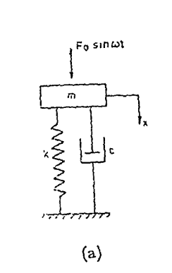
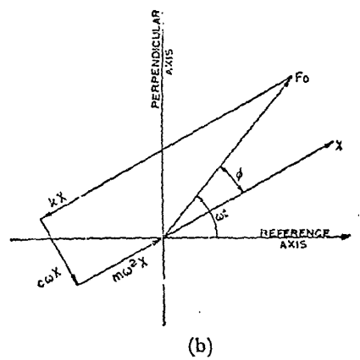
Force transmissibility
Transmissibility in case of force excited system is defined as the ratio of the force transmitted to the foundation to that impressed upon the system.
Fig. (a) shows a mass support on the foundation by means of an isolator having an equivalent stiffness and damping.
Under steady state conditions, forces acting on the mass can be represented by means of a vector diagram (Fig. b).
Spring force and dashpot force are the two common forces acting on the mass as well as foundation.

Slide 25
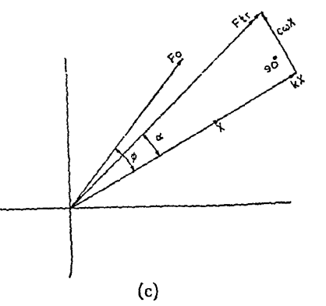
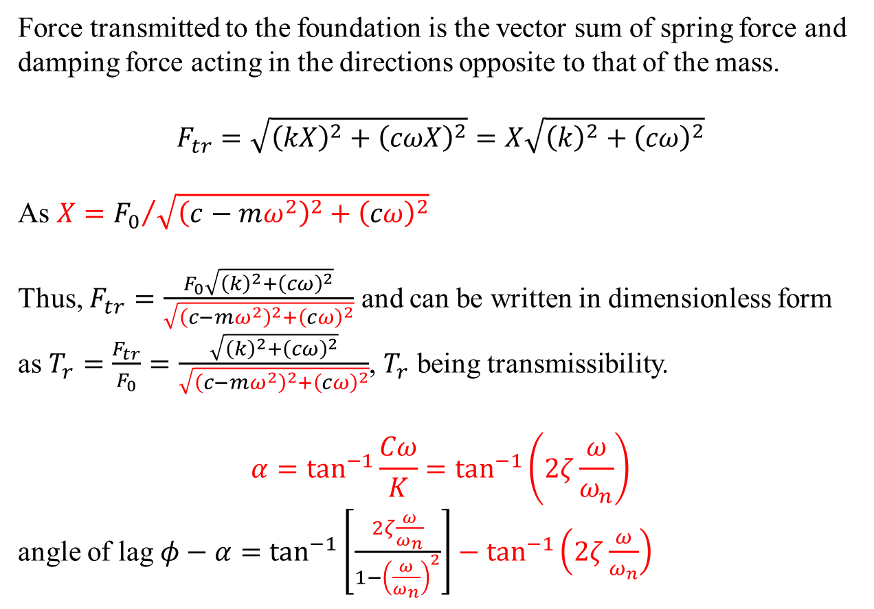
Force transmissibility
Force transmitted to the foundation is the vector sum of spring force and damping force acting in the directions opposite to that of the mass.
$$F_{tr}=\sqrt{{\left(kX\right)}^{2}+{\left(cωX\right)}^{2}}=X\sqrt{{\left(k\right)}^{2}+{\left(cω\right)}^{2}}$$
As $X={F_{0}}/{\sqrt{{\left(c−mω^{2}\right)}^{2}+{\left(cω\right)}^{2}}}$
Thus, $F_{tr}=\frac{F_{0}\sqrt{{\left(k\right)}^{2}+{\left(cω\right)}^{2}}}{\sqrt{{\left(c−mω^{2}\right)}^{2}+{\left(cω\right)}^{2}}}$ and can be written in dimensionless form
as $T_{r}=\frac{F_{tr}}{F_{0}}=\frac{\sqrt{{\left(k\right)}^{2}+{\left(cω\right)}^{2}}}{\sqrt{{\left(c−mω^{2}\right)}^{2}+{\left(cω\right)}^{2}}}$, $T_{r}$ being transmissibility.
$$α=\tan^{−1}{\frac{Cω}{K}}=\tan^{−1}\left(2ζ\frac{ω}{ω_{n}}\right)$$
angle of lag $φ−α=\tan^{−1}\left[\frac{2ζ\frac{ω}{ω_{n}}}{1−{\left(\frac{ω}{ω_{n}}\right)}^{2}}\right]−\tan^{−1}\left(2ζ\frac{ω}{ω_{n}}\right)$

Slide 26
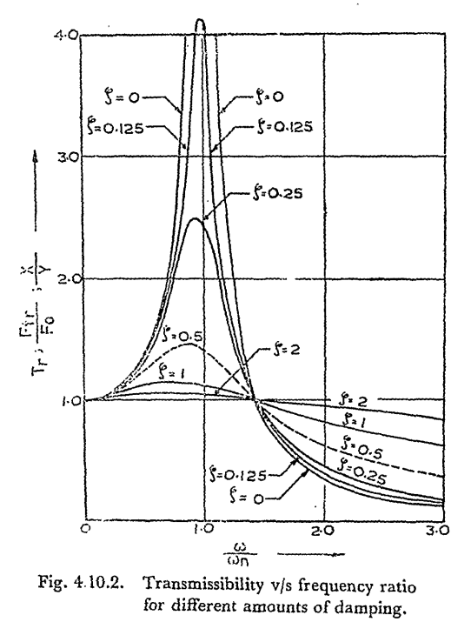
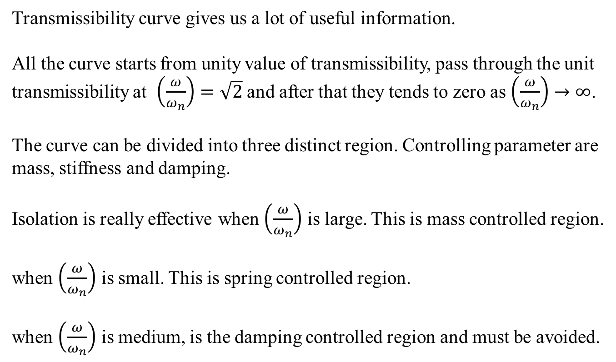
Force transmissibility
Transmissibility curve gives us a lot of useful information.
All the curve starts from unity value of transmissibility, pass through the unit transmissibility at $\left(\frac{ω}{ω_{n}}\right)=\sqrt{2}$ and after that they tends to zero as $\left(\frac{ω}{ω_{n}}\right)→∞$.
The curve can be divided into three distinct region. Controlling parameter are mass, stiffness and damping.
Isolation is really effective when $\left(\frac{ω}{ω_{n}}\right)$ is large. This is mass controlled region.
when $\left(\frac{ω}{ω_{n}}\right)$ is small. This is spring controlled region.
when $\left(\frac{ω}{ω_{n}}\right)$ is medium, is the damping controlled region and must be avoided.

Slide 27
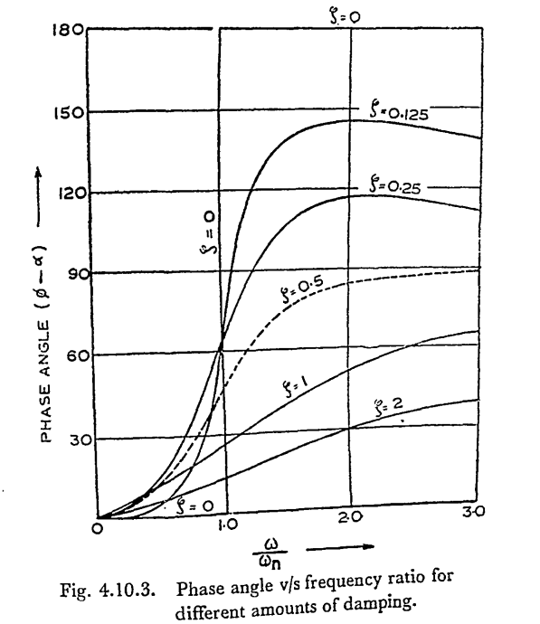
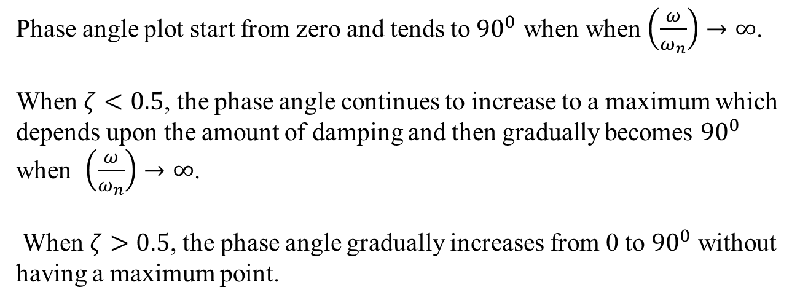
Force transmissibility
Phase angle plot start from zero and tends to ${90}^{0}$ when when $\left(\frac{ω}{ω_{n}}\right)→∞$.
When $ζ<0.5$, the phase angle continues to increase to a maximum which depends upon the amount of damping and then gradually becomes ${90}^{0}$ when $\left(\frac{ω}{ω_{n}}\right)→∞$.
When $ζ>0.5$, the phase angle gradually increases from 0 to ${90}^{0}$ without having a maximum point.

Slide 28
Motion transmissibility

Slide 29
Typical isolators and mount types
The typical isolators are coil spring and the elastomers (rubber and neoprene). Coil spring have negligible internal damping while neoprene has sufficient amount of it.
Steel springs
Pad mounts
General purpose elastomeric mounts

Slide 30
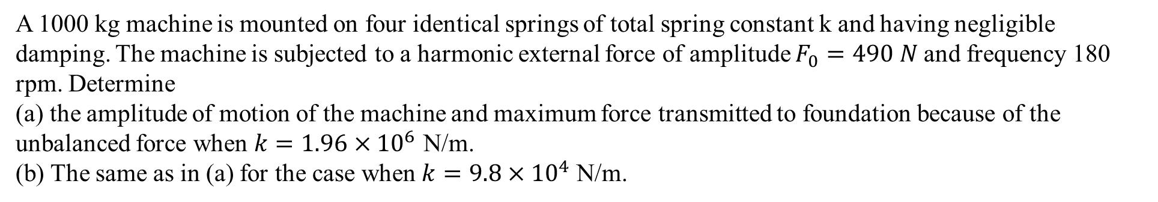
Example
A 1000 kg machine is mounted on four identical springs of total spring constant k and having negligible damping. The machine is subjected to a harmonic external force of amplitude $F_{0}=490 N$and frequency 180 rpm. Determine
(a) the amplitude of motion of the machine and maximum force transmitted to foundation because of the unbalanced force when $k=1.96×{10}^{6}$ N/m.
(b) The same as in (a) for the case when $k=9.8×{10}^{4}$ N/m.

Slide 31
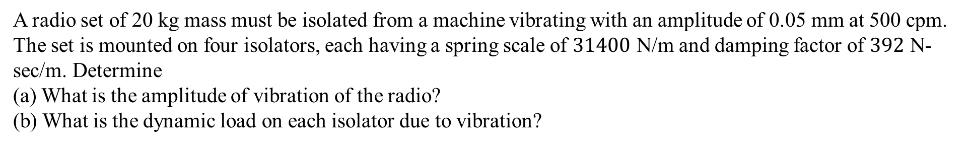
Example
A radio set of 20 kg mass must be isolated from a machine vibrating with an amplitude of 0.05 mm at 500 cpm. The set is mounted on four isolators, each having a spring scale of $31400$ N/m and damping factor of $392$ N-sec/m. Determine
(a) What is the amplitude of vibration of the radio?
(b) What is the dynamic load on each isolator due to vibration?

Slide 32
Acknowledgement
Mechanical vibrations: S S Rao
Mechanical Vibrations: G. K. Grover
NPTEL Lectures on Mechanical vibration

